Slide 1
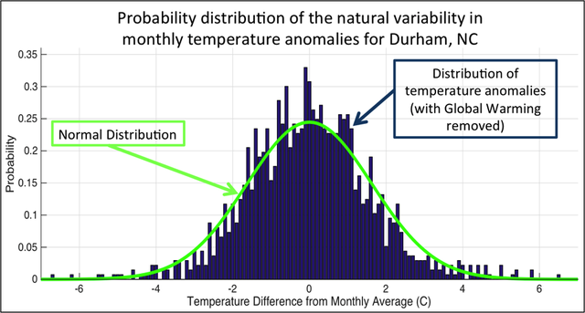
About Chapter 1 of G&R Climate as a statistical idea
Climate is a distribution of possible possible weather states
Weather is a state in the distribution
Extremes – the sides of the distribution
Modeling consists of knowing the current state and using physics-based equations to project it forward.
Numerical Weather Prediction (NWP) models are sophisticated models used to project into the future (a few days).
Earth.nullschool.net is a reanalysis model – a model that actively incorporates measurements. Also good for a few days into the future.
Global Climate Models (GCMs) project farther into the future. Accuracy is not good past a week or two, but we hope the statistics are reliable.

Slide 2
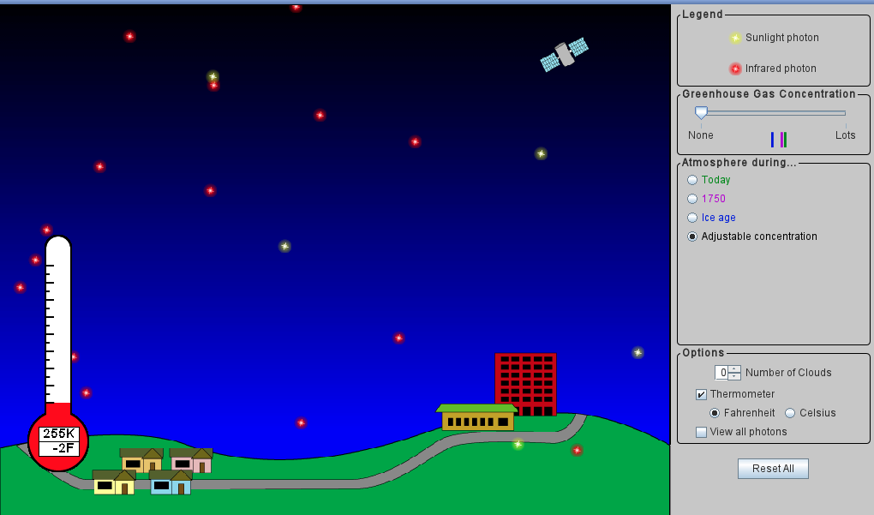
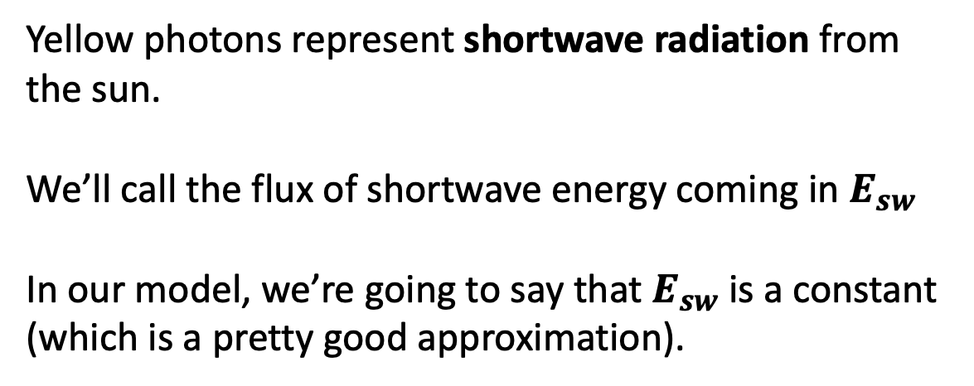
Principle of radiative balance
Yellow photons represent shortwave radiation from the sun.
We’ll call the flux of shortwave energy coming in $E_{sw}$
In our model, we’re going to say that $E_{sw}$ is a constant (which is a pretty good approximation).
https://phet.colorado.edu/sims/cheerpj/greenhouse/latest/greenhouse.html?simulation=greenhouse

Slide 3
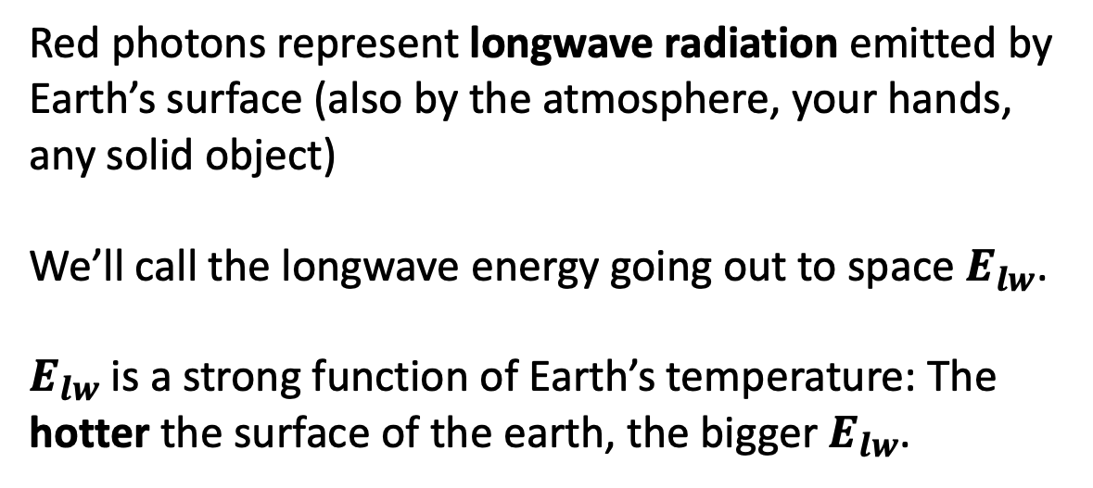
Principle of radiative balance
Red photons represent longwave radiation emitted by Earth’s surface (also by the atmosphere, your hands, any solid object)
We’ll call the longwave energy going out to space $E_{lw}$.
$E_{lw}$ is a strong function of Earth’s temperature: The hotter the surface of the earth, the bigger $E_{lw}$.
https://phet.colorado.edu/sims/cheerpj/greenhouse/latest/greenhouse.html?simulation=greenhouse

Slide 4
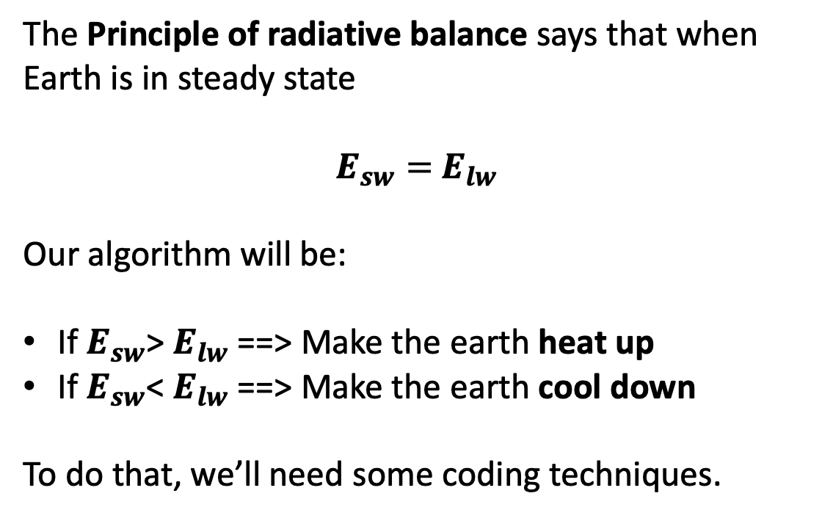
Principle of radiative balance
The Principle of radiative balance says that when Earth is in steady state
$E_{sw}=$ $E_{lw}$
Our algorithm will be:
If $E_{sw}$> $E_{lw}$ ==> Make the earth heat up
If $E_{sw}$< $E_{lw}$ ==> Make the earth cool down
To do that, we’ll need some coding techniques.
https://phet.colorado.edu/sims/cheerpj/greenhouse/latest/greenhouse.html?simulation=greenhouse

Slide 5
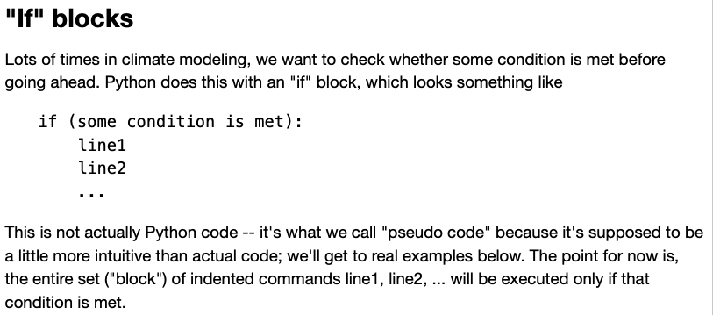
“If” blocks

Slide 6
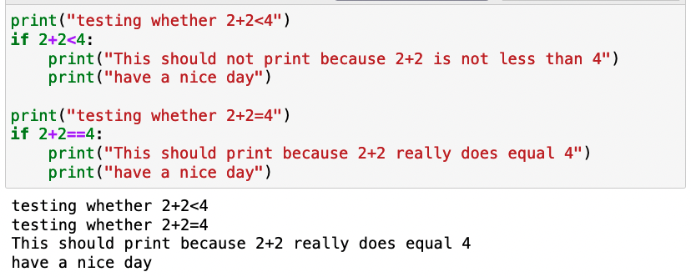
Example of an “If” block

Slide 7
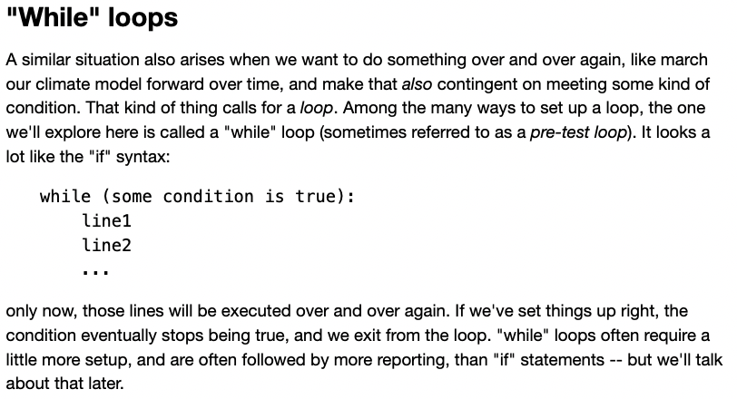
“While” loops

Slide 8
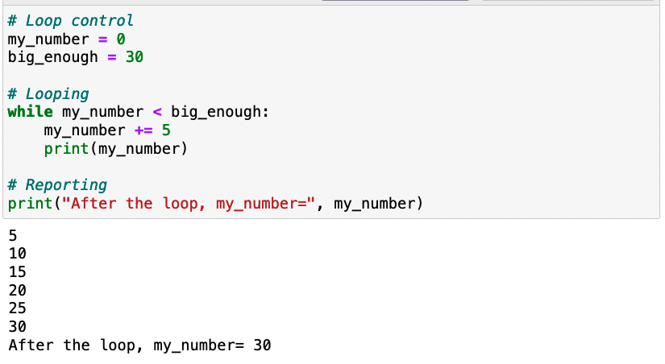
Example of a “While” loop

Slide 9
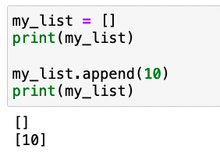
Building up lists by appending

Slide 10
Building up lists by appending

Slide 11
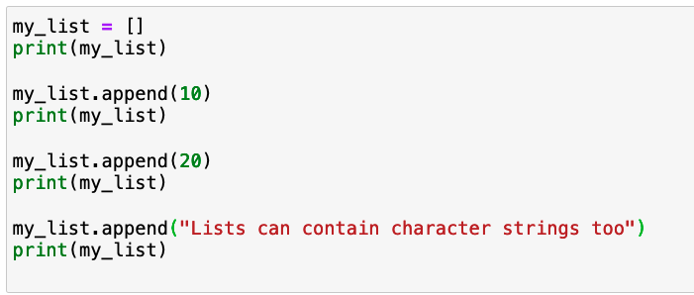
Building up lists by appending

Slide 12
This loop prints stuff out, but doesn’t save anything

Slide 13
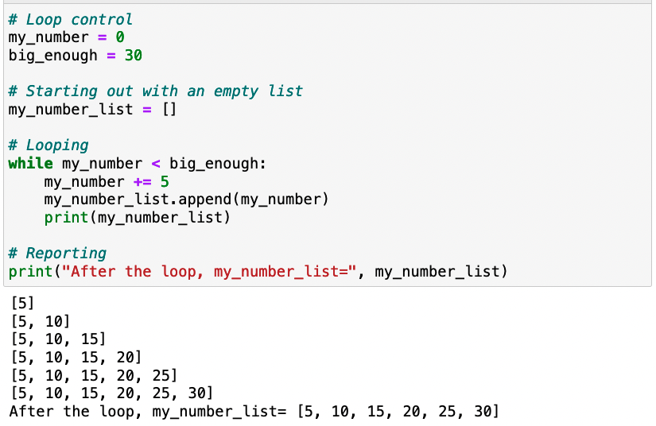
This loop prints stuff out and saves it in a list by appending!

Slide 14
This loop prints stuff out and saves it in a list by appending!

Slide 15
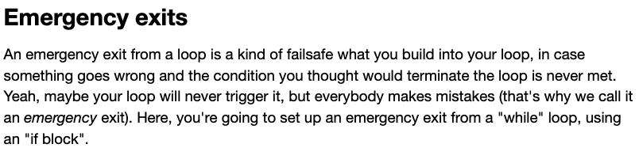
Emergency exits (from a loop)

Slide 16
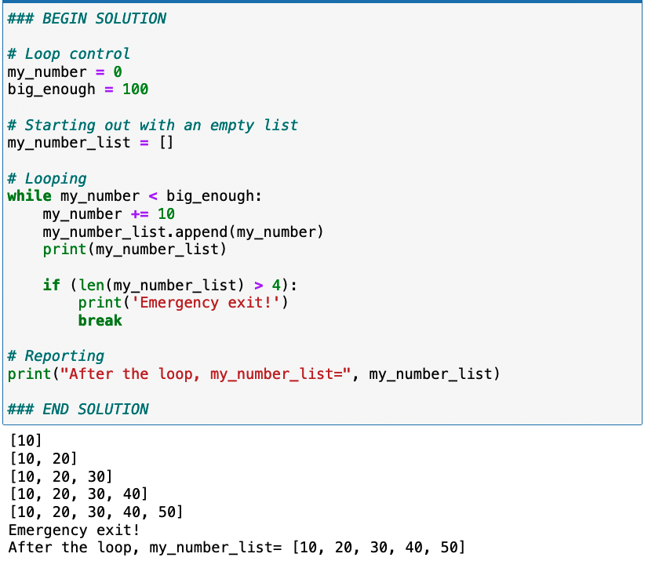
Example of an emergency exit

Slide 17
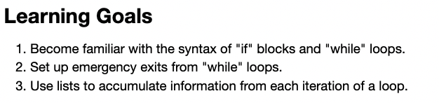
Summary of learning goals

